Slide 1
Book xchange
202101 IC115 group-9
Jenishkumar dhirajlal rank
Dipesh kamleshbhai patel

Slide 2
Theme
Book eXchange

Slide 3

MOTIVATION
“Exchanging books save you time, money, shelf space, and environment.”

Slide 4

Website Definition
BookXchange is a community for exchanging used books for free.
It's a great crime to have a book disappear, out of print, for none to read. We keep books in circulation and find new readers for them.
You give your books you no longer need in exchange for book you really want.
We strive to make a platform where locals exchange books and try to contribute to the community.

Slide 5
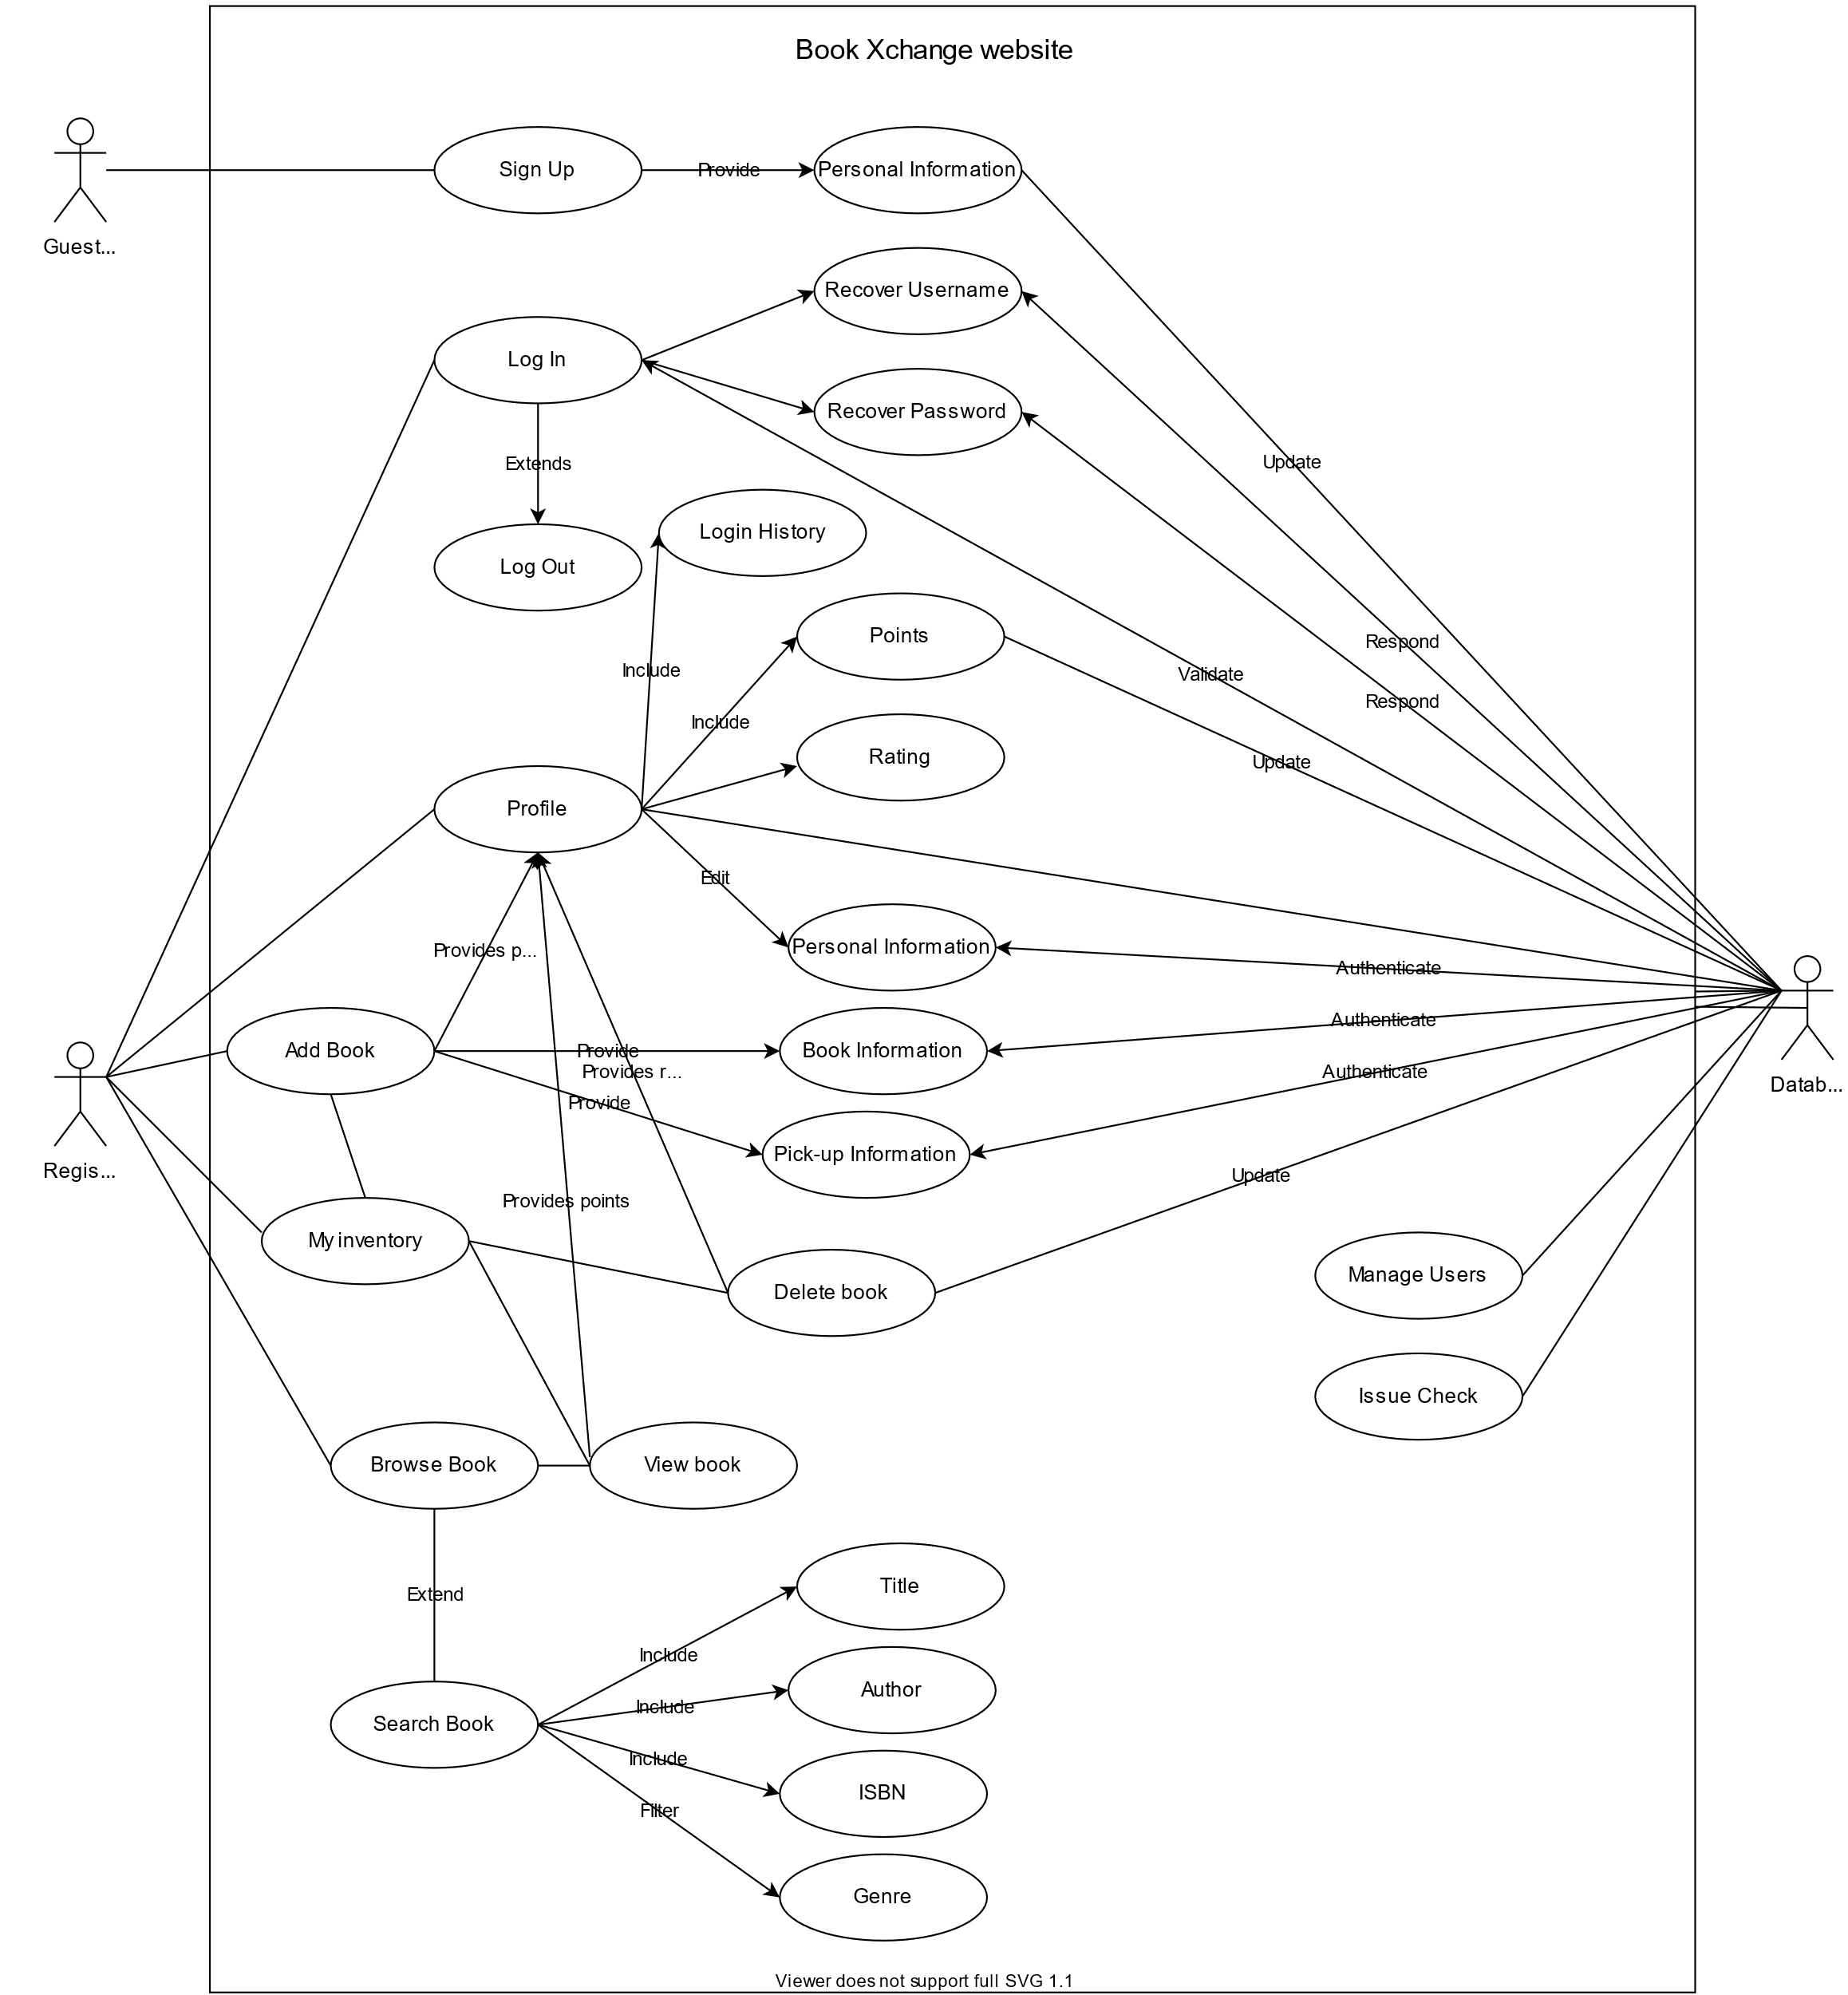
Use case diagram

Slide 6
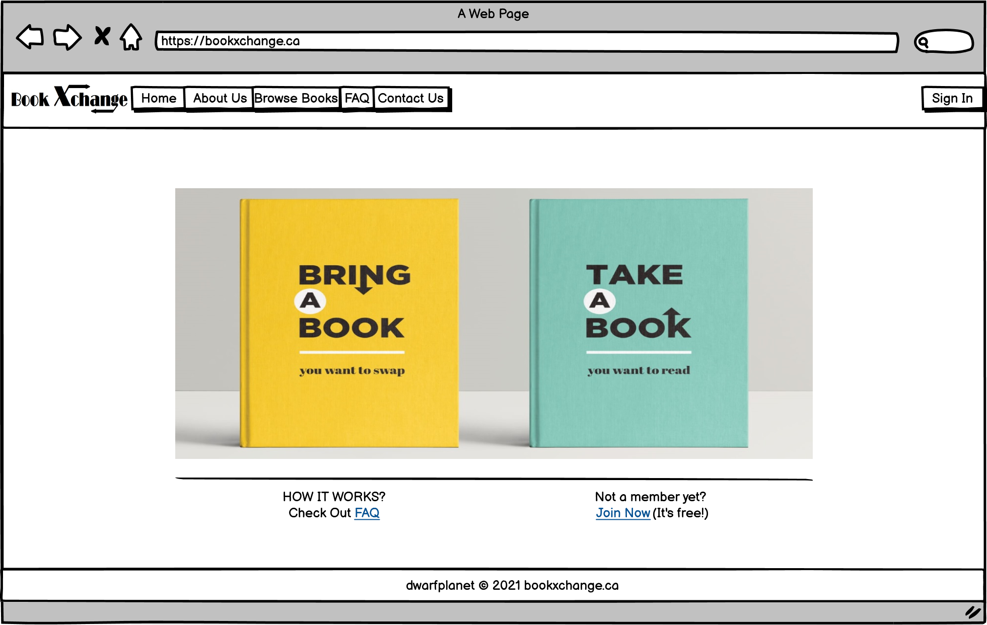
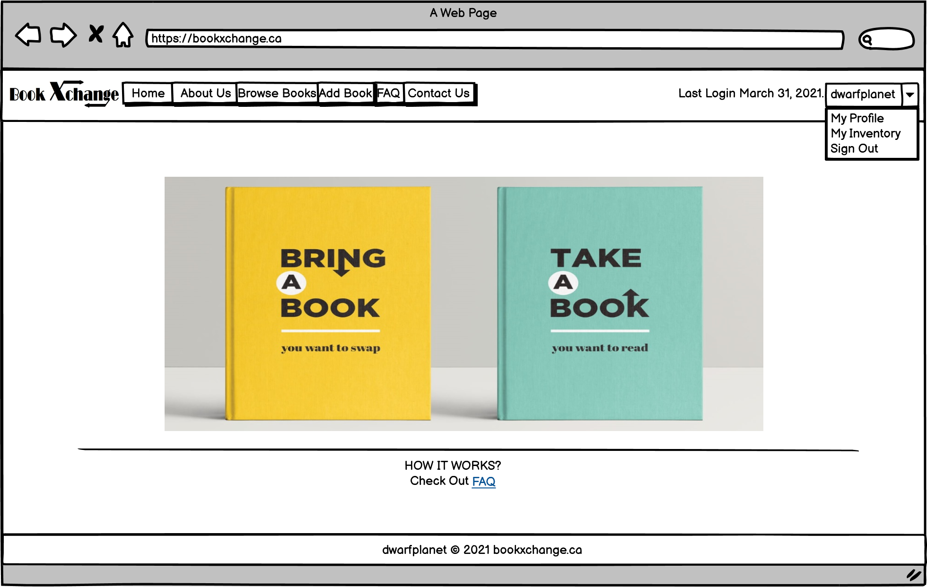
Website Wireframes
WEBSITE INDEX
HOME

Slide 7
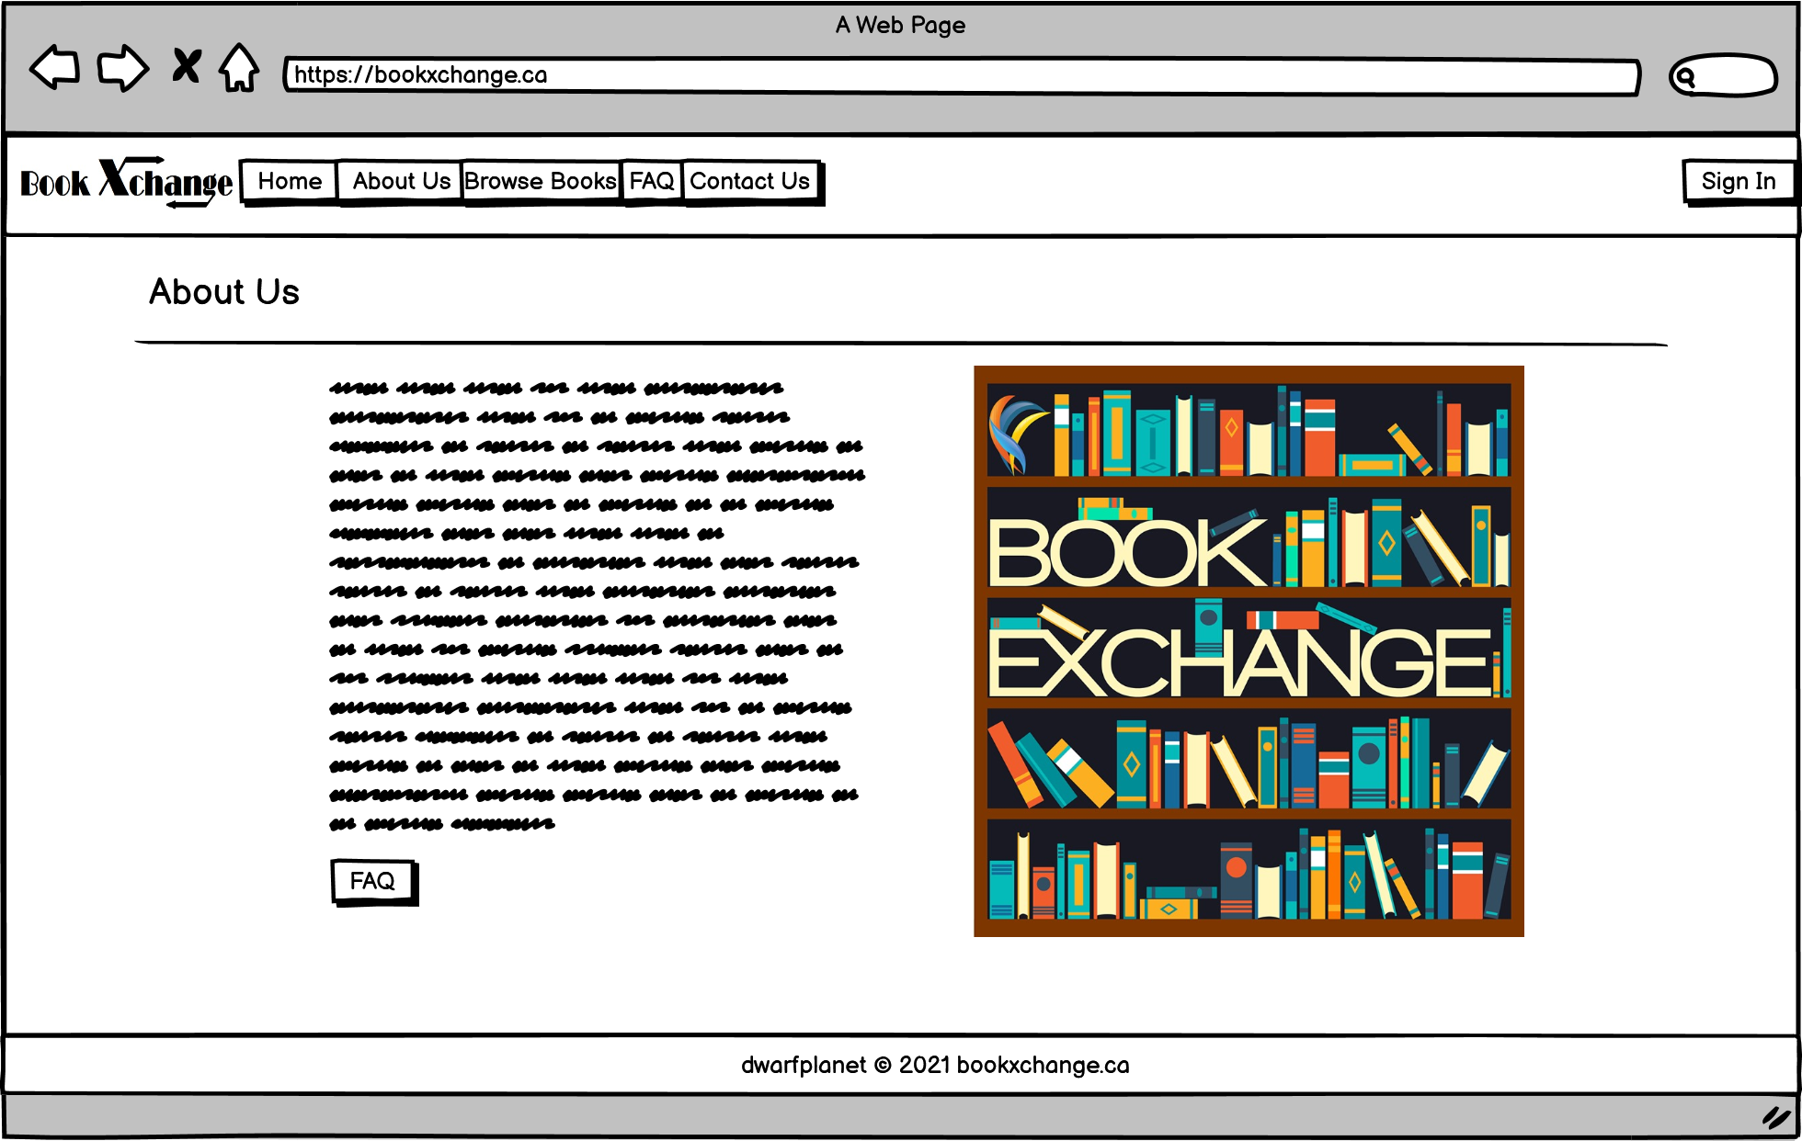
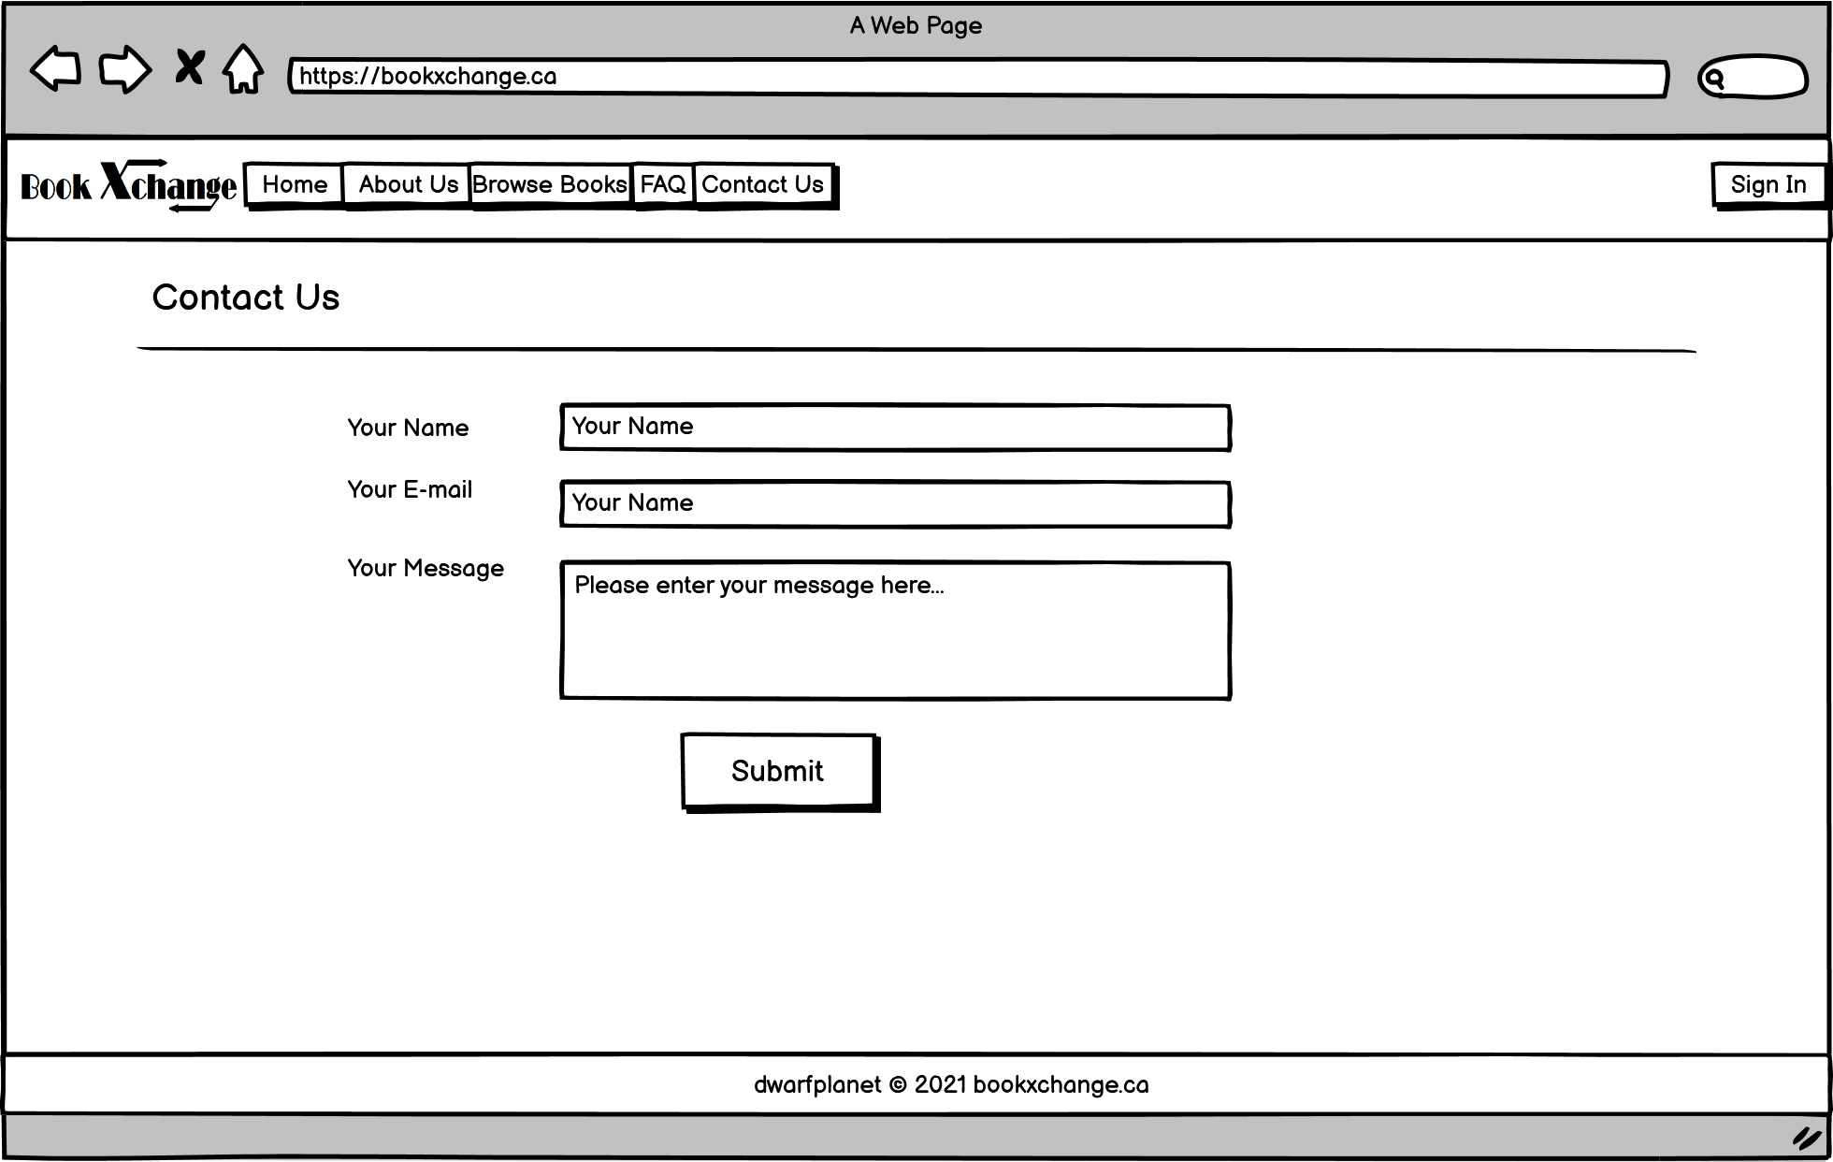
Website Wireframes (CONT.)
ABOUT US
CONTACT US

Slide 8
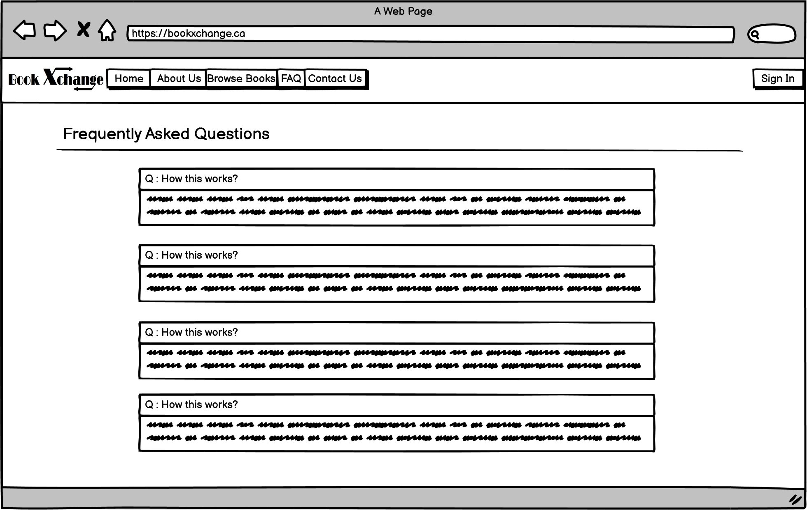
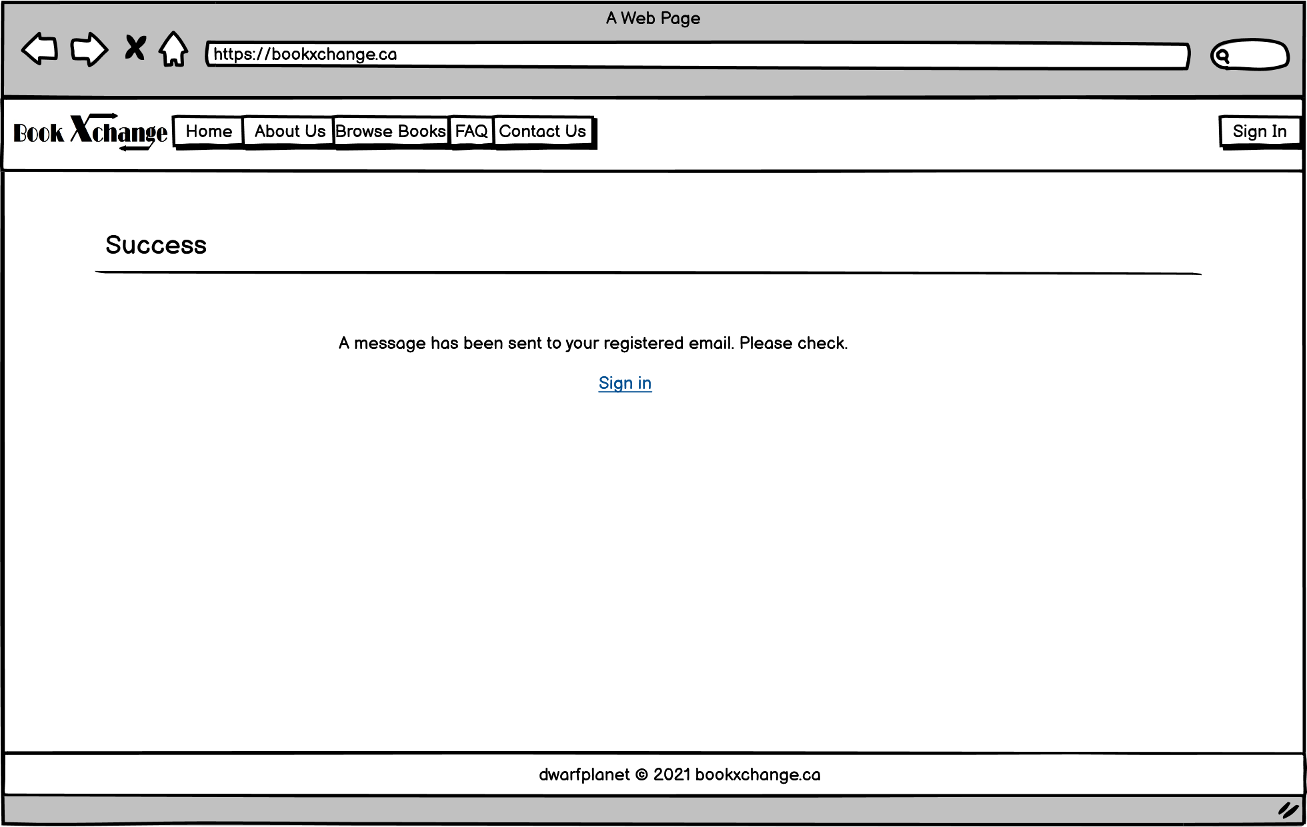
Website Wireframes (CONT.)
FAQ
Success

Slide 9
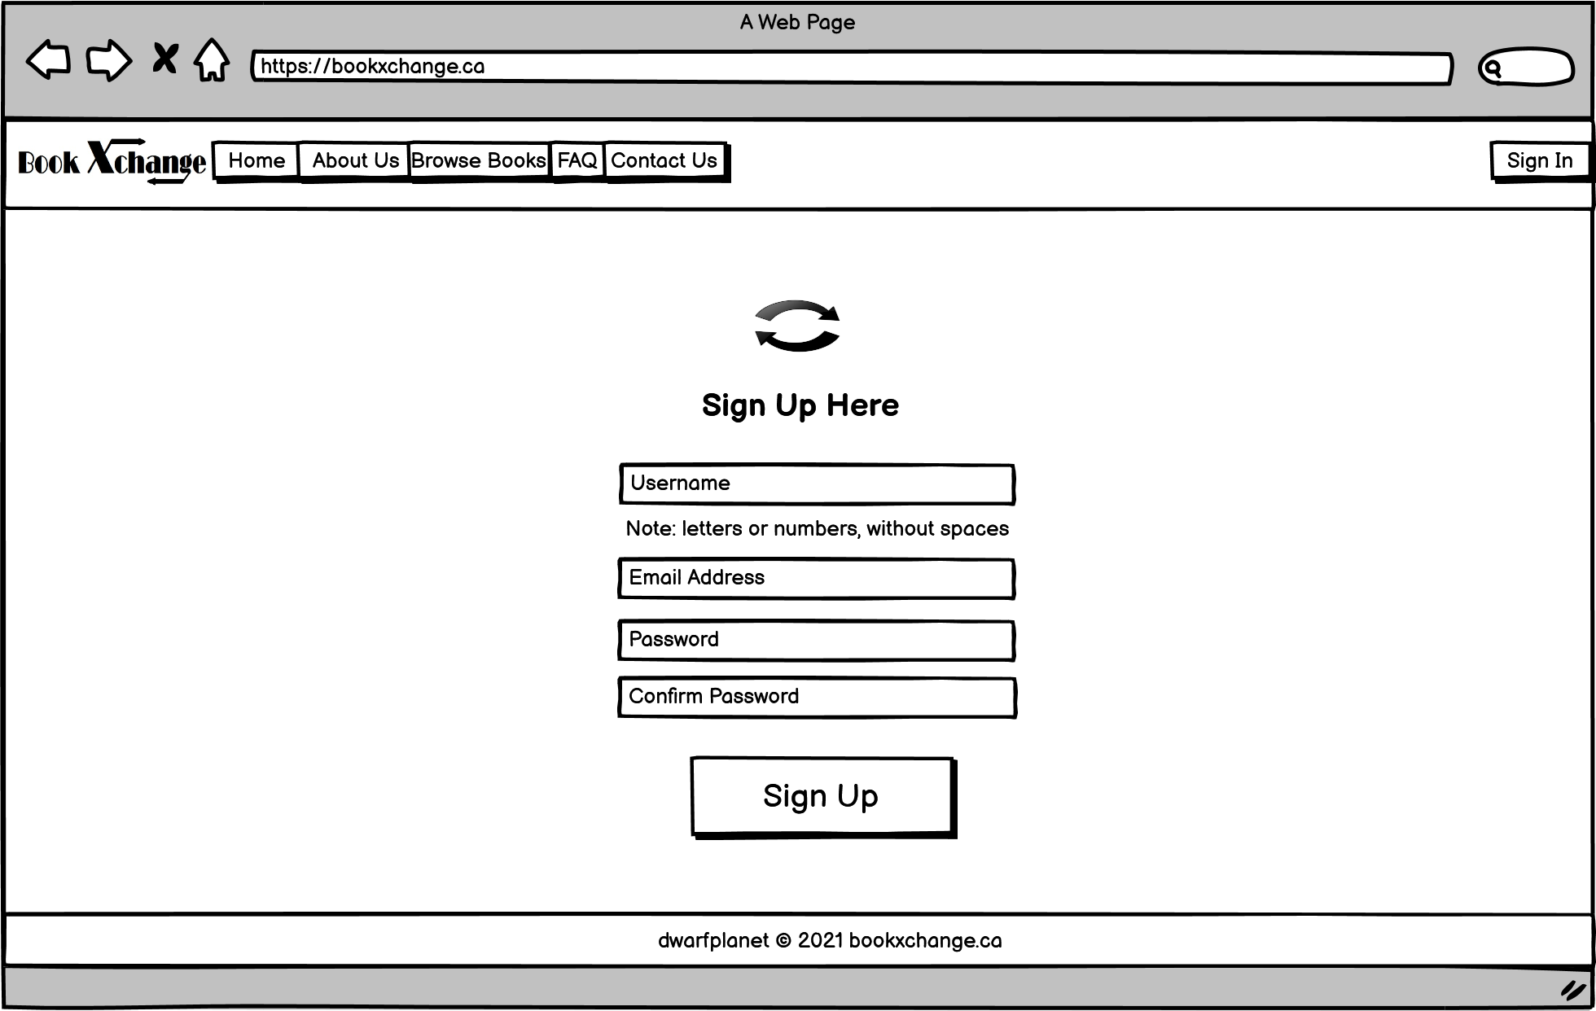
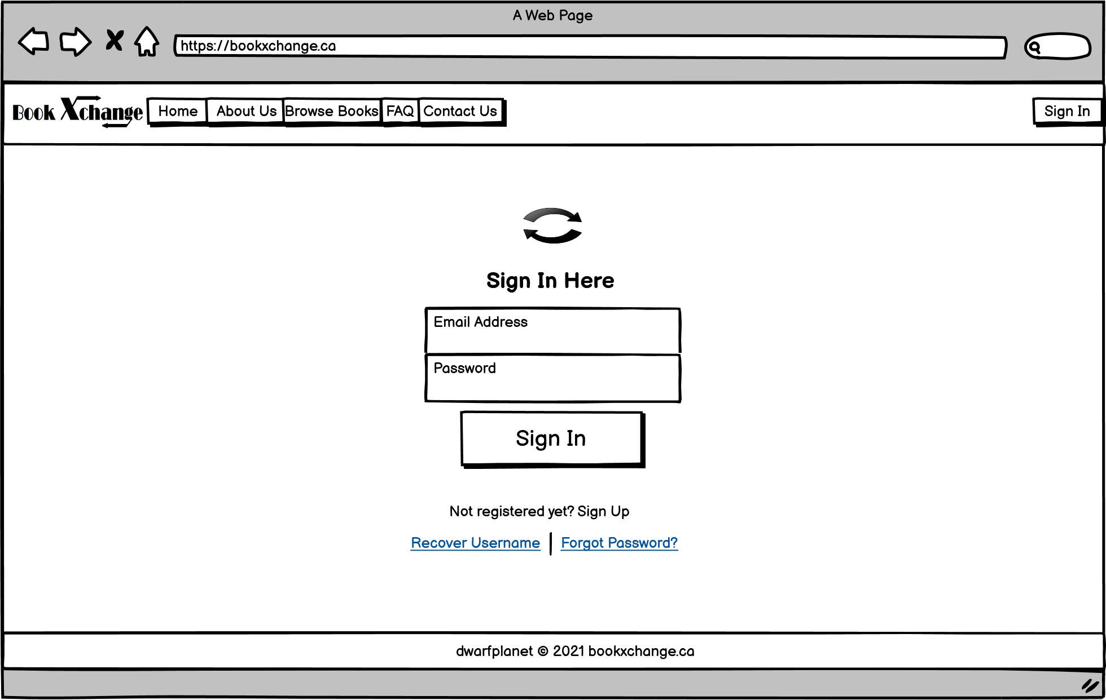
Website Wireframes (CONT.)
SIGN UP
SIGN IN

Slide 10
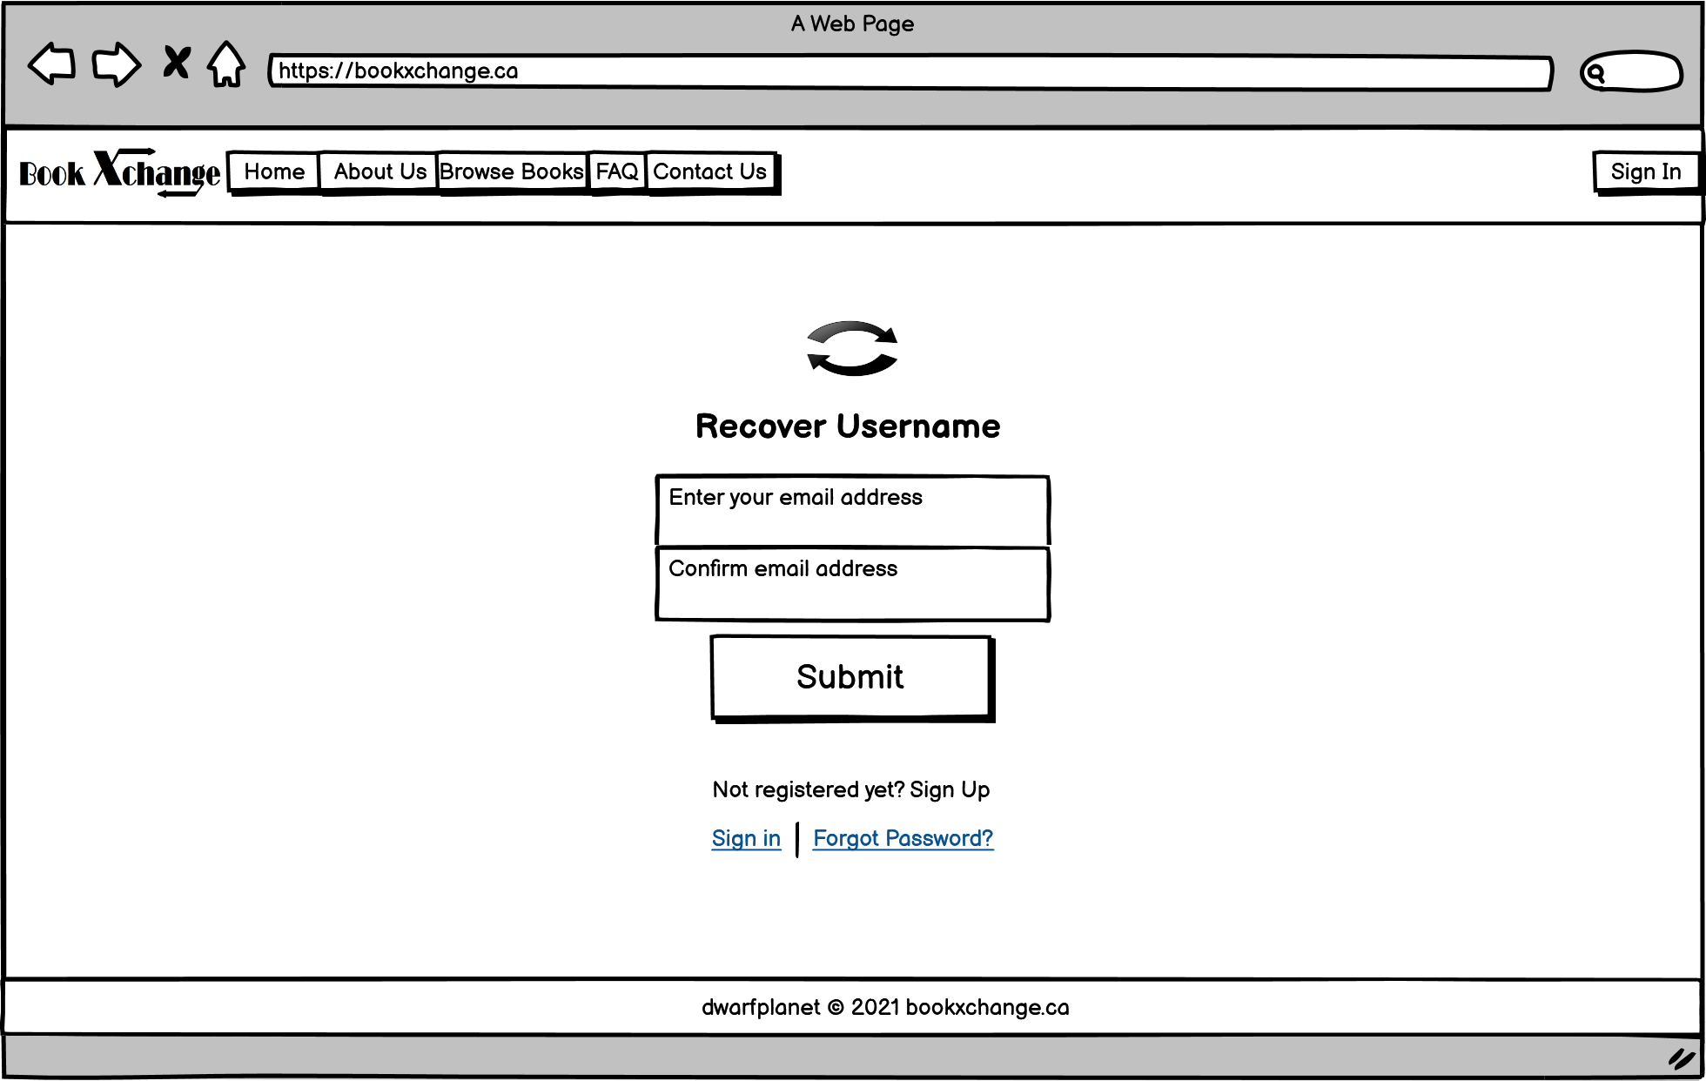
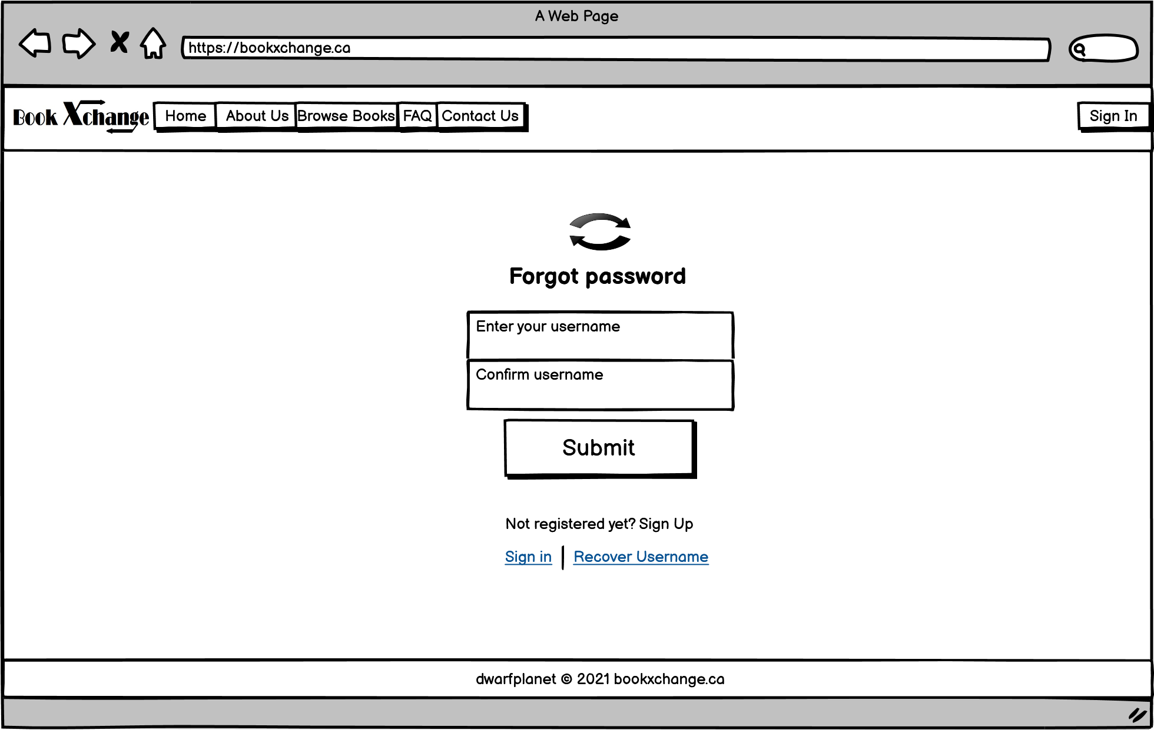
Website Wireframes (CONT.)
RECOVER USERNAME
FORGOT PASSWORD

Slide 11
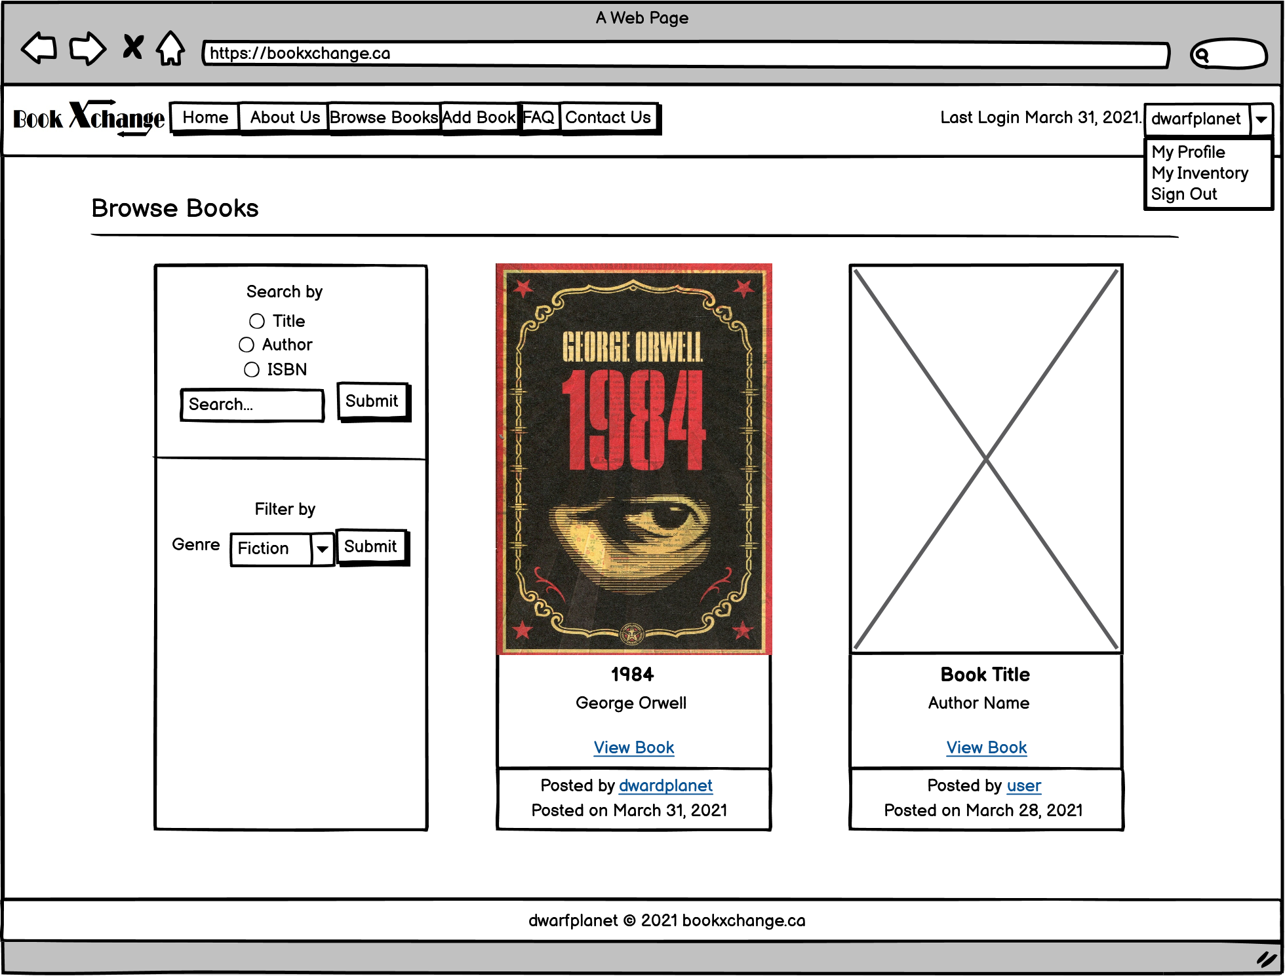
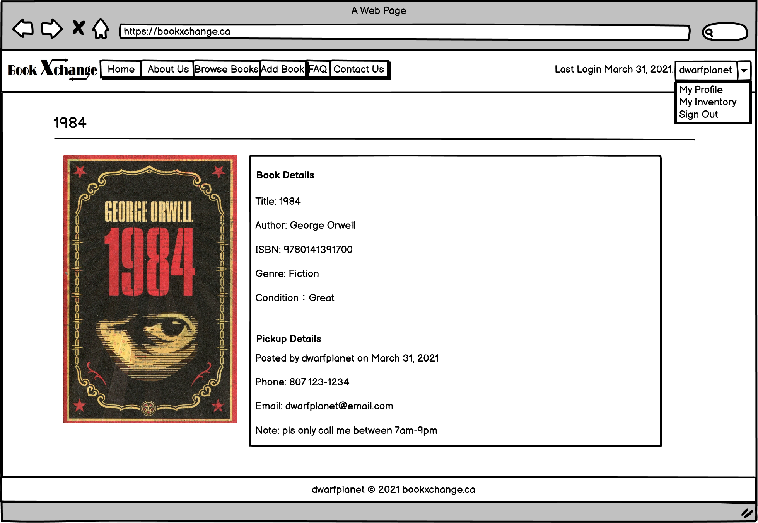
Website Wireframes (CONT.)
BROWSE
VIEW BOOK

Slide 12
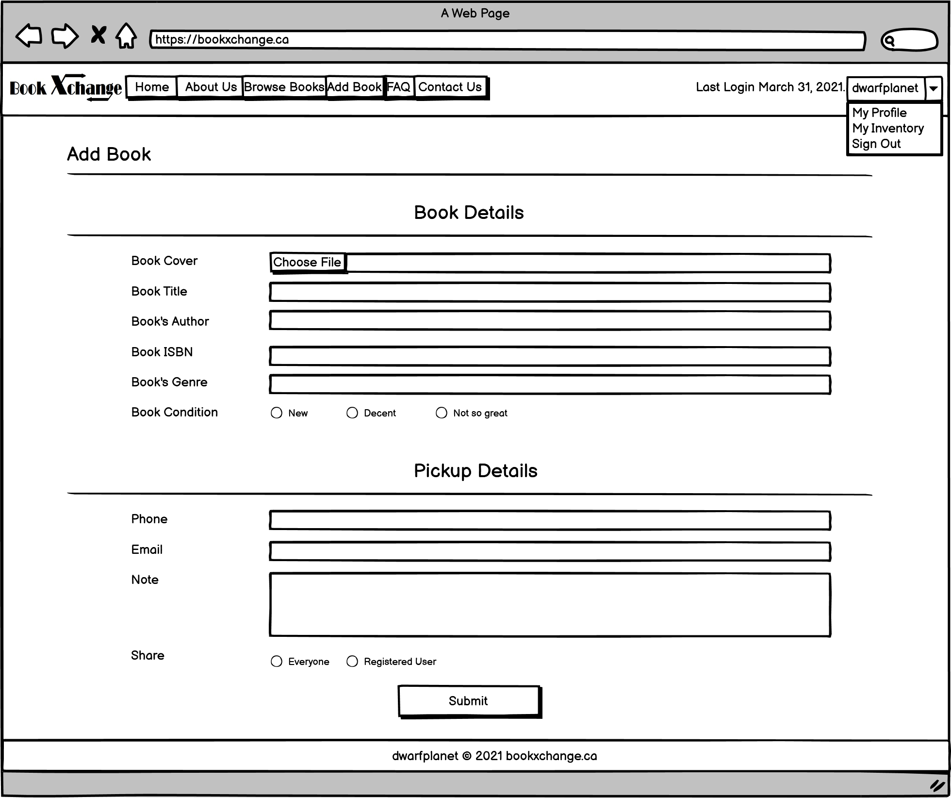
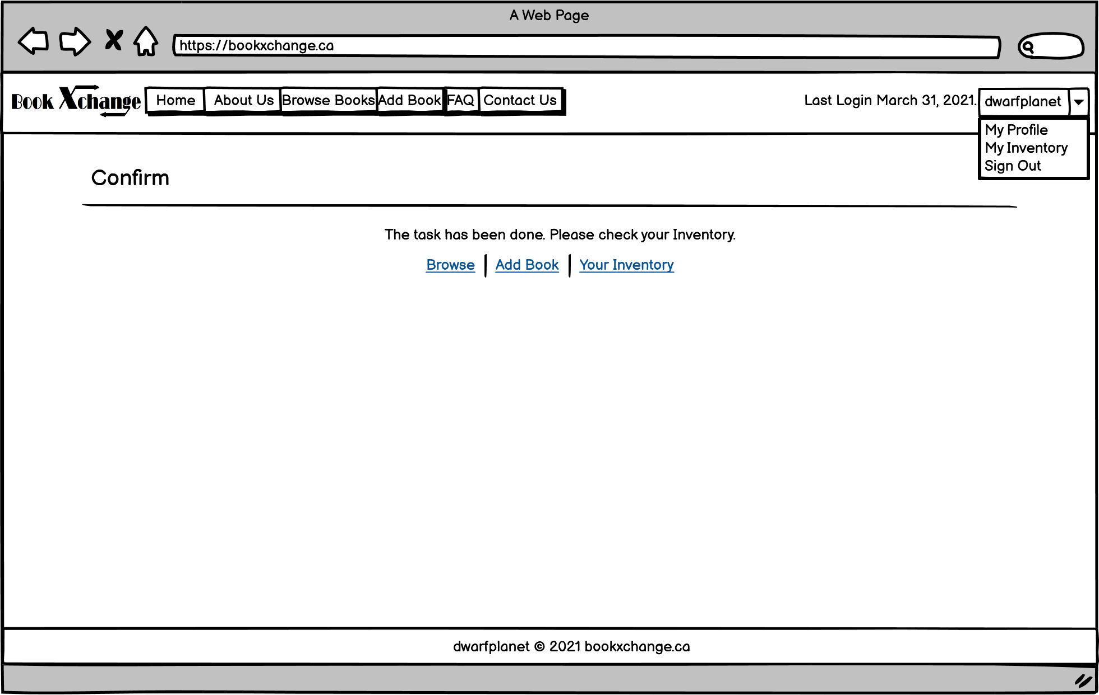
Website Wireframes (CONT.)
ADD BOOK
ADD CONFIRM

Slide 13
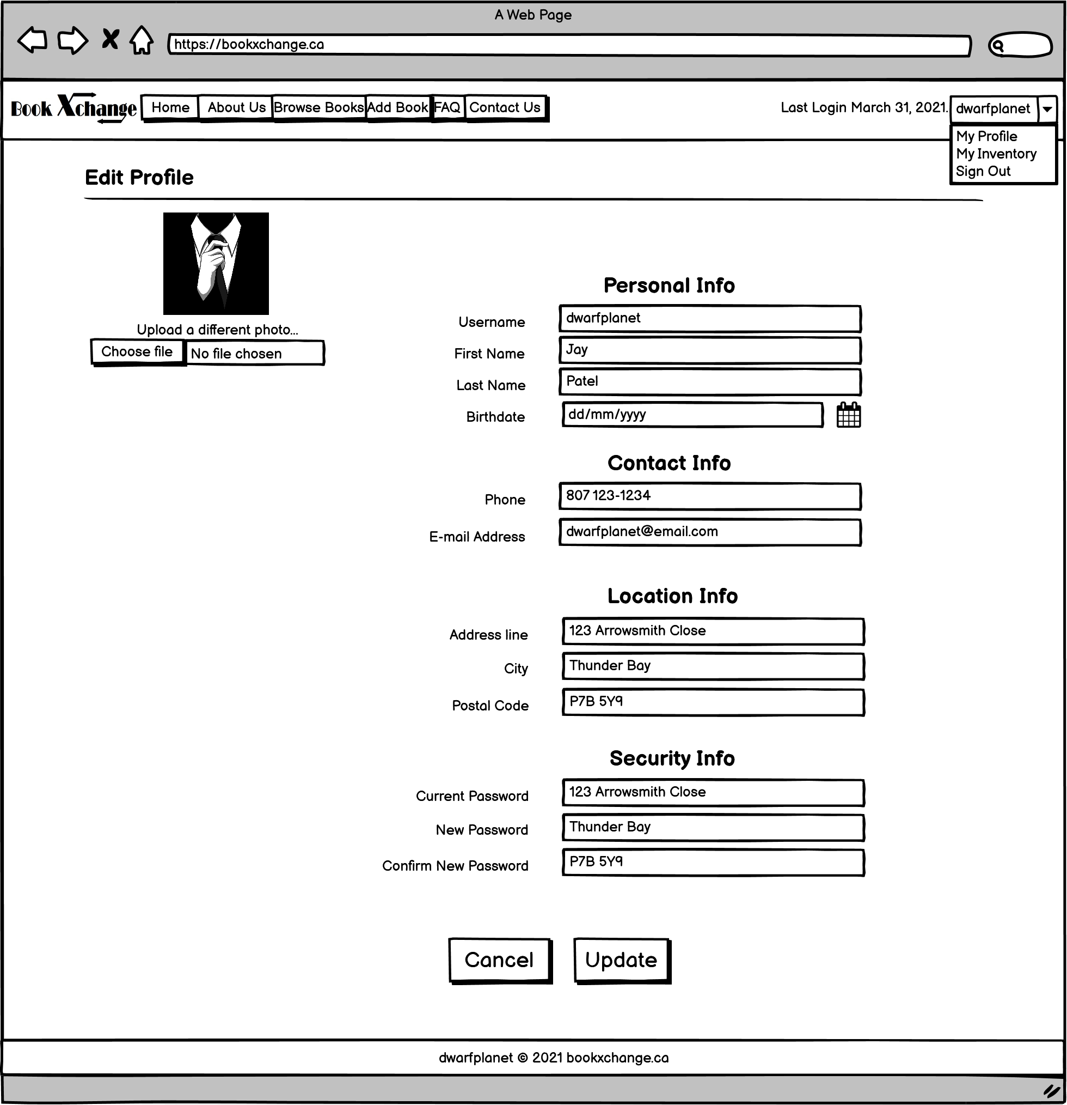
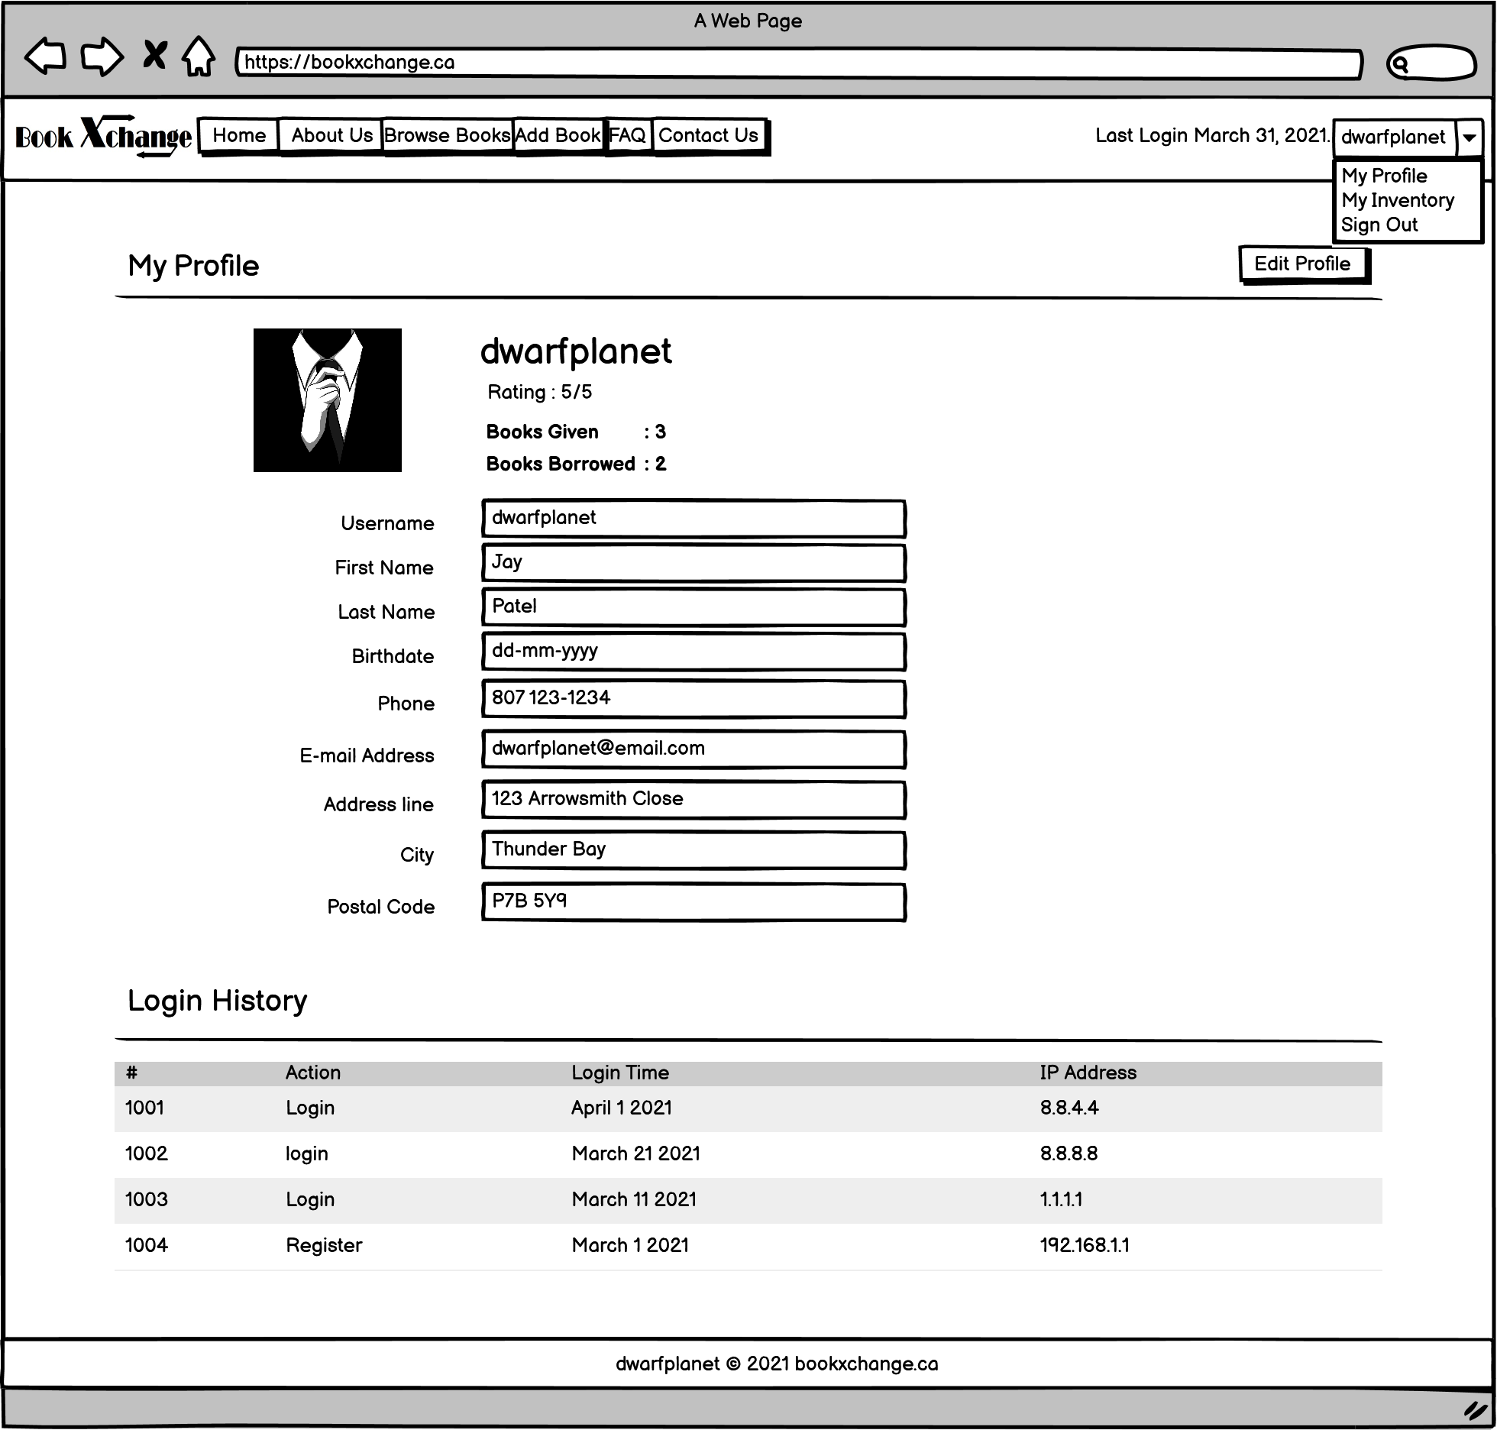
Website Wireframes (CONT.)
MY PROFILE
EDIT PROFILE

Slide 14
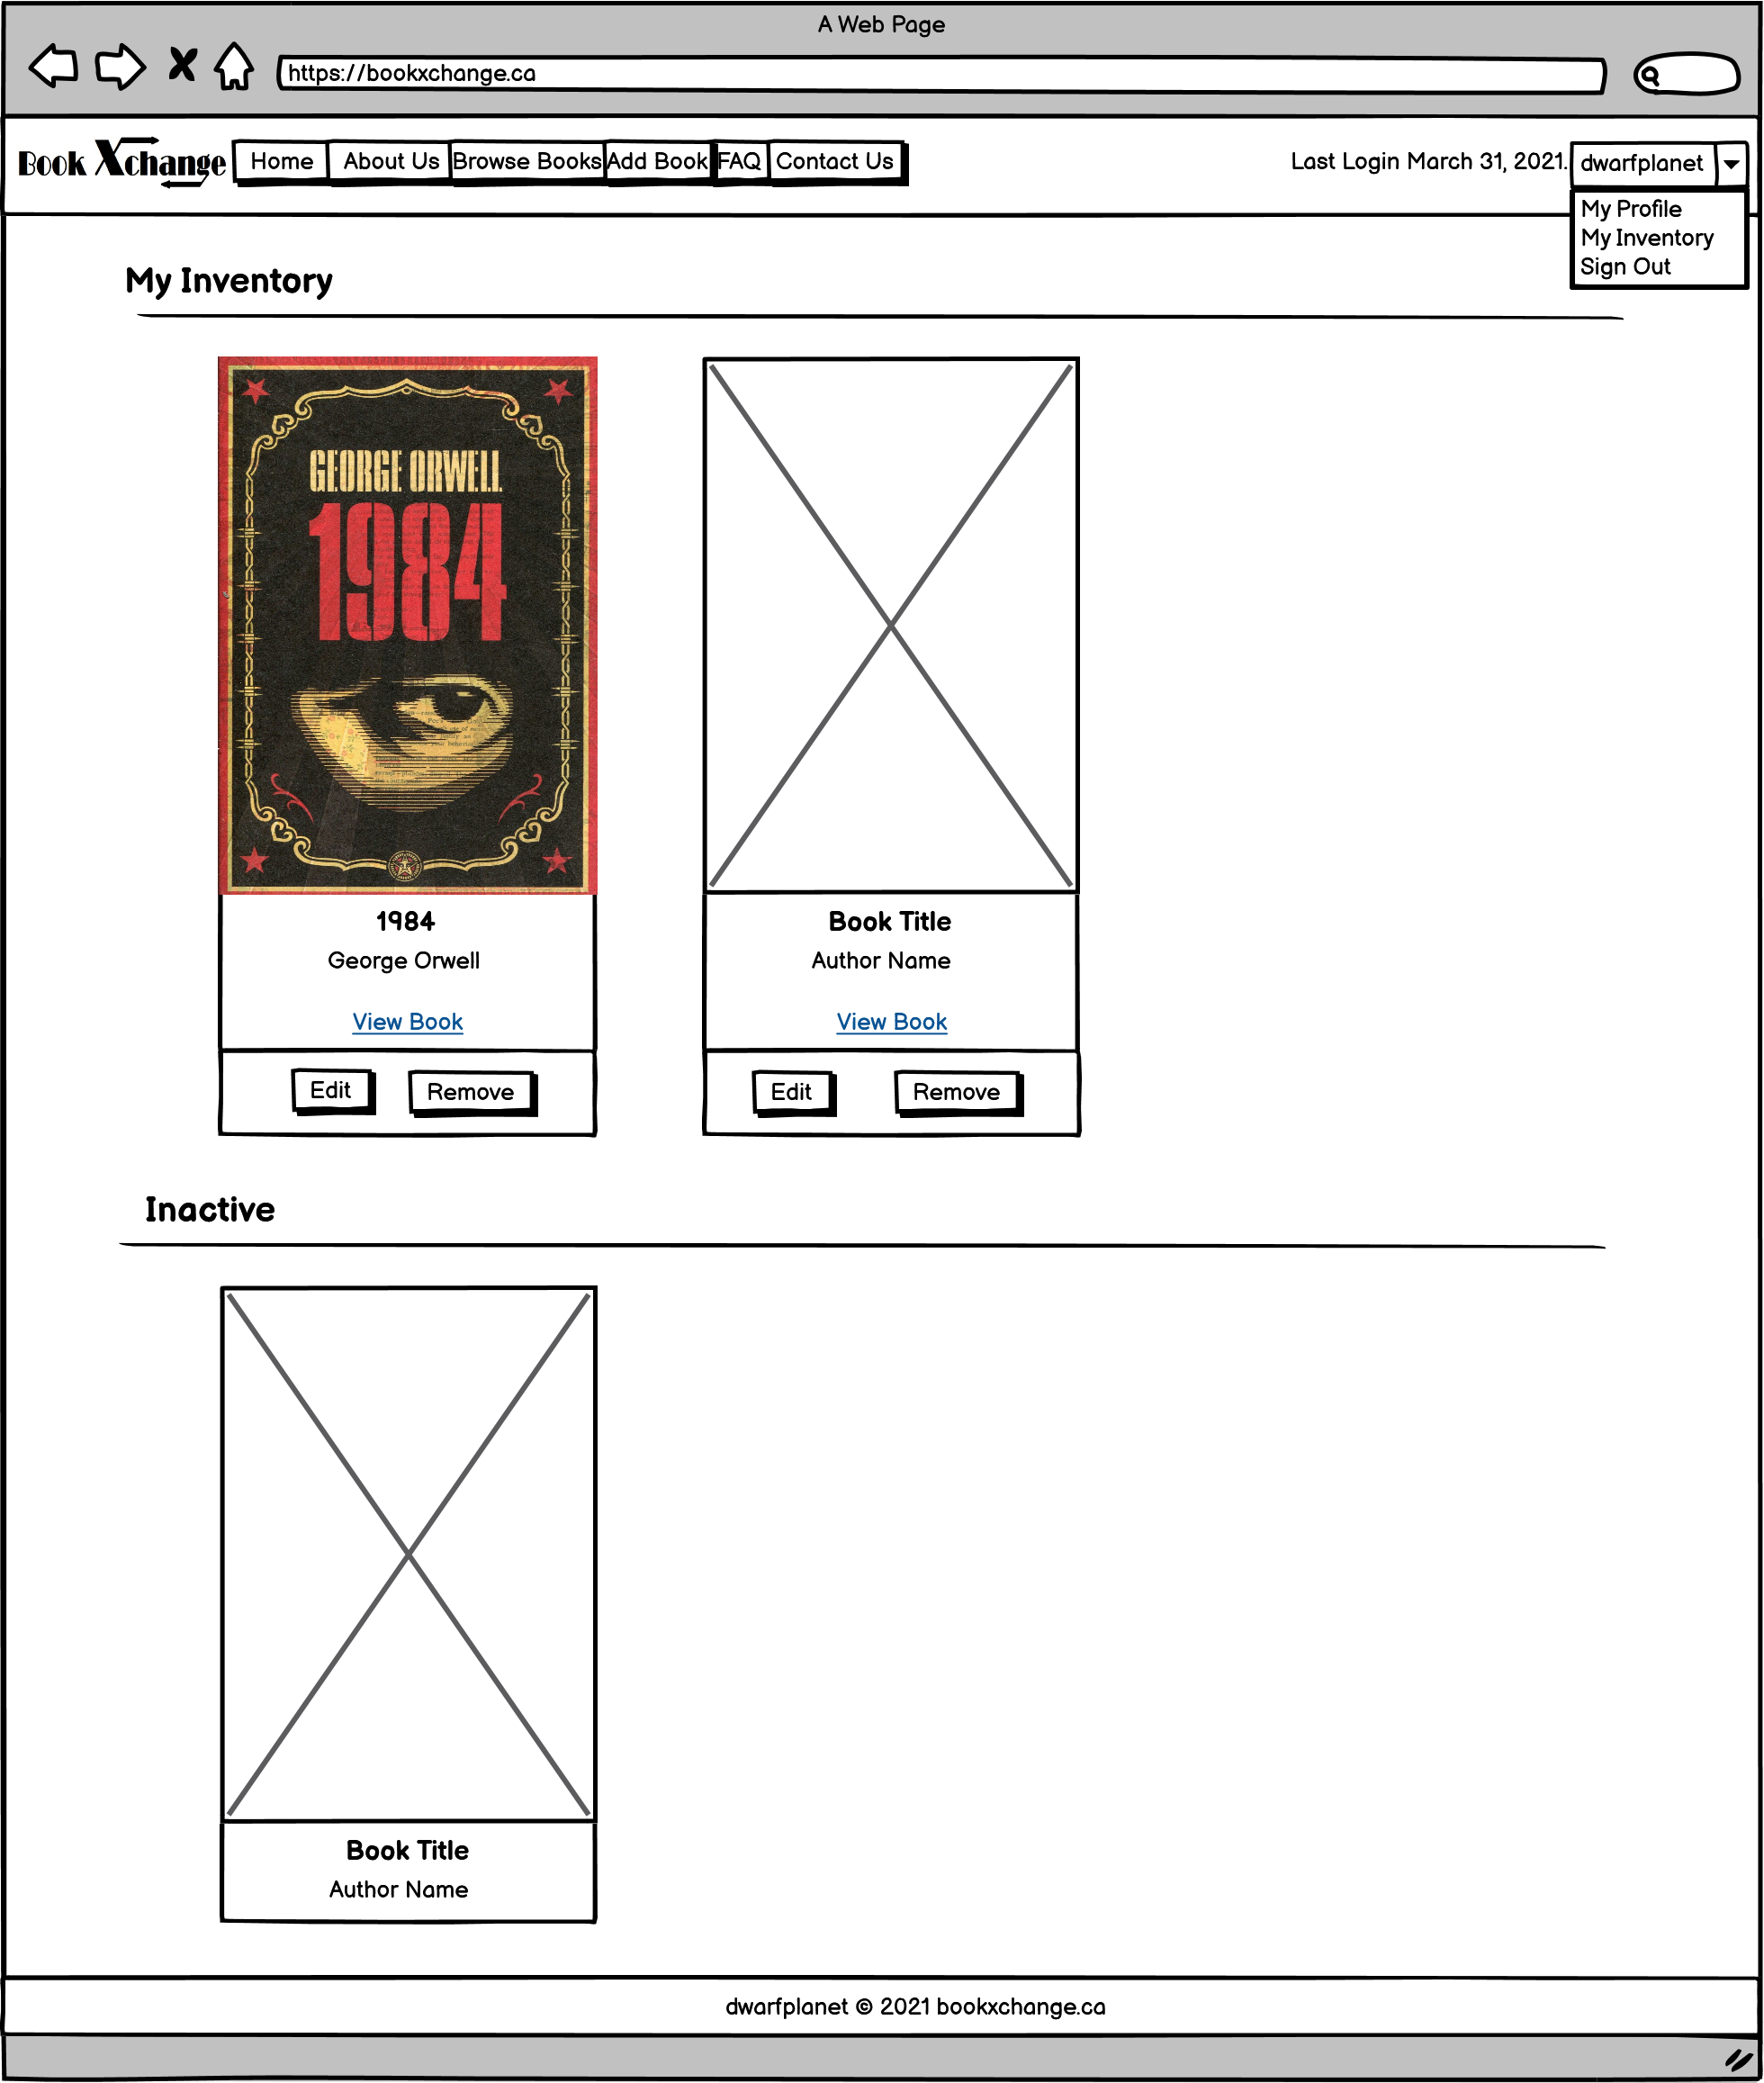
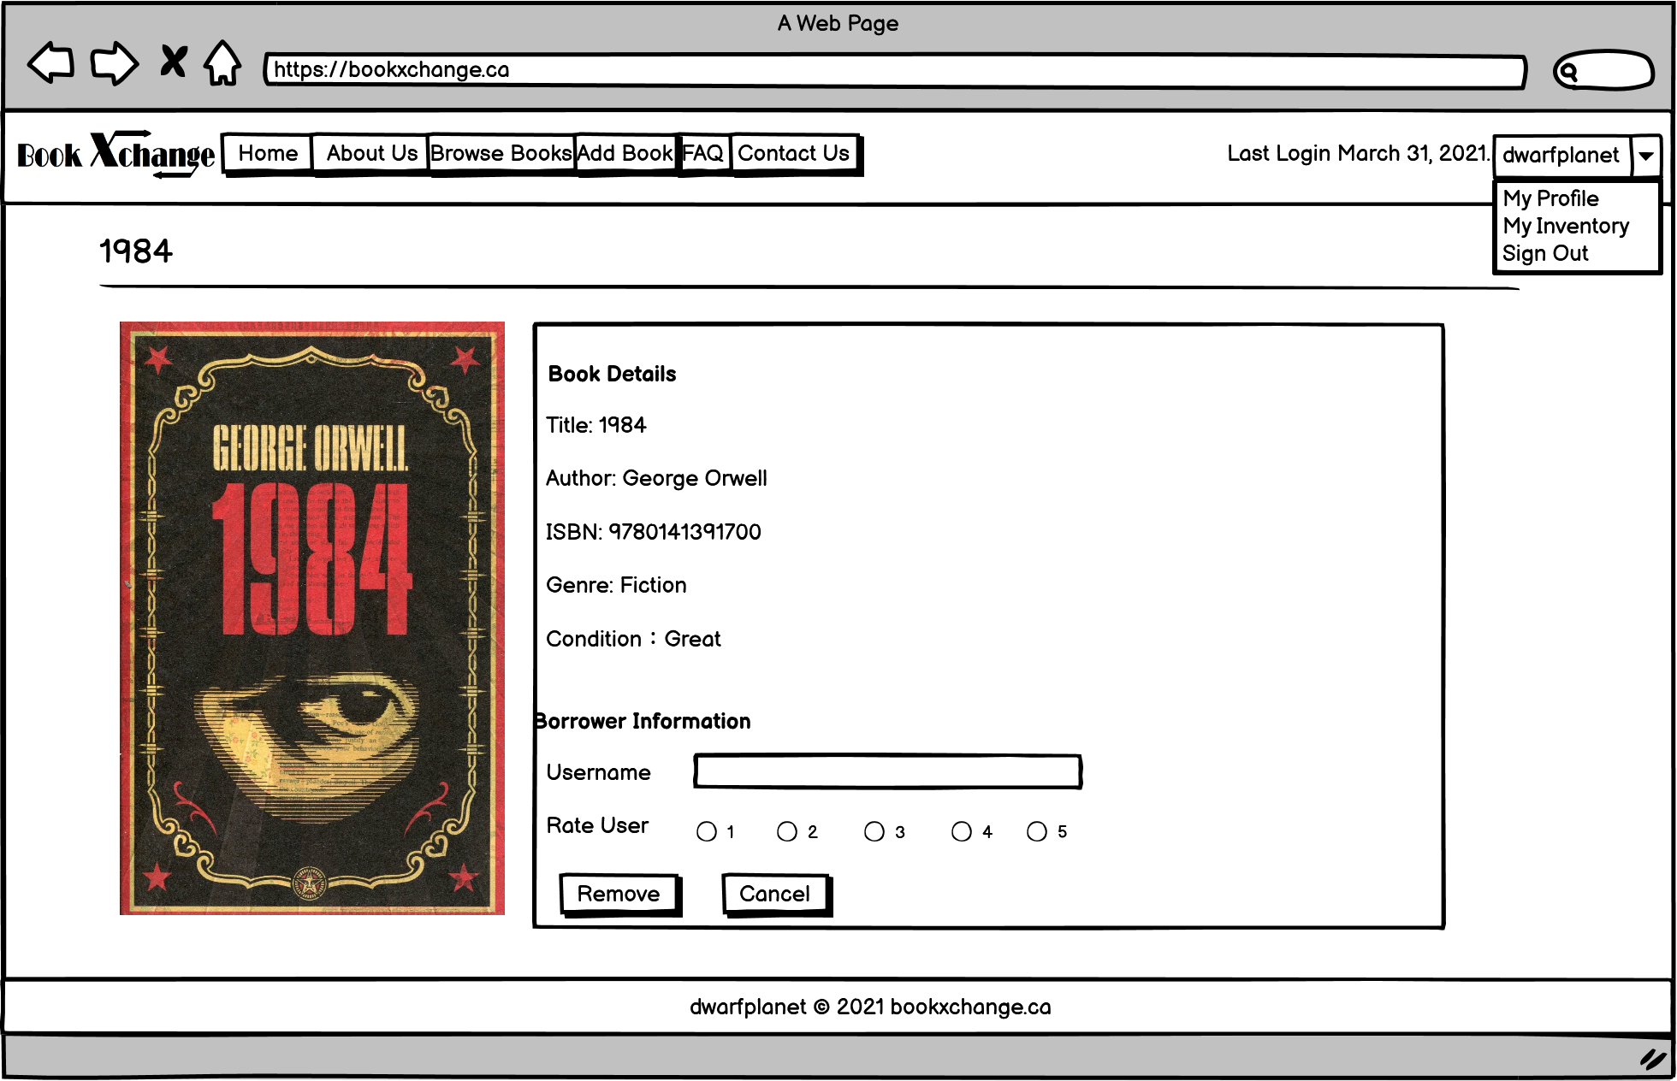
Website Wireframes (CONT.)
MY INVENTORY
REMOVE BOOK

Slide 15

Thank You!!!

